Slide 1
NIU Huskies –
Future Forecasters
Steve Dziamentsyeu, Brandon Curtin, Kamila Tkacz, Daniel Major

Slide 2
Agenda
01
02
03
04
05
06
Exposure Analysis
Hurricane Data
At-Risk Location Data
An analysis of exposures in the location portfolio
Wind speed and hurricane type trends
Set of hurricanes that pass within 1º of a portfolio location
Conclusions
Interface
Areas of Uncertainty
Relationships between location and hurricane data

Slide 3
BUT FIRST: Assumptions
There is only one hurricane associated with a given hurricane name / year pairing
Probable maximum loss (max loss | disaster occurs) = Total Insured Value
Rationale: HELP only insures buildings → max loss implies complete loss of building → probable max loss = TIV
TIV inflation [2021, 2024] ~ US inflation [2021, 2024]
Rationale: most locations are in the US
All hurricanes within 1 degree range impose identical loss distributions on the given location
Rationale: lack of data on catastrophic losses = no way to reconcile hurricane wind speed / proximity with expected catastrophic loss
Expected Hurricane Frequency is approximately uniform
Rationale: Hurricane count by year does not exhibit any strong trends

Slide 4
01
Exposure Analysis

Slide 5
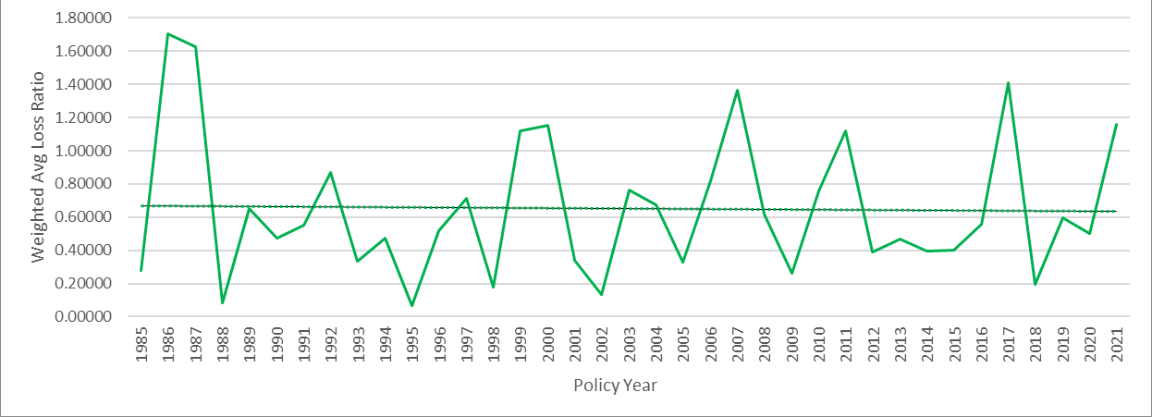
Average Loss Ratio Weighted by TIV Over Time
Weighted by TIV =
Better measure of
business impact
Master Data → Exposures

Slide 6
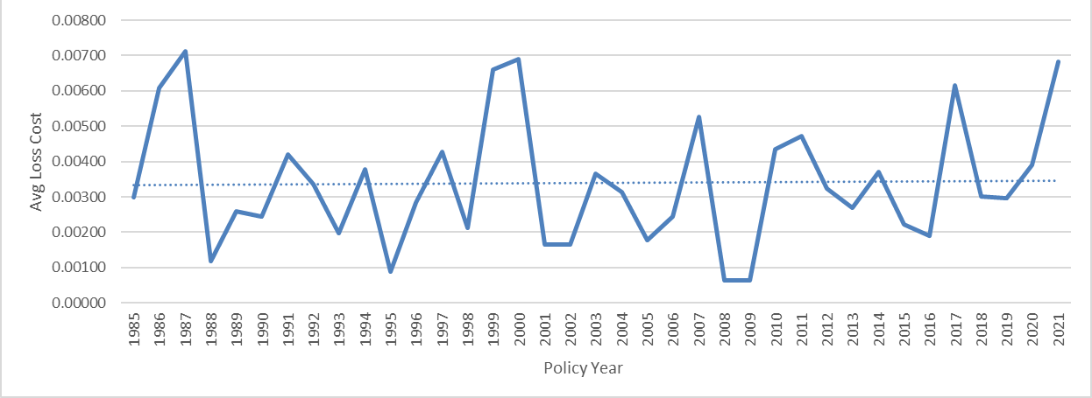
Average Loss Cost Over Time
Master Data → Exposures

Slide 7
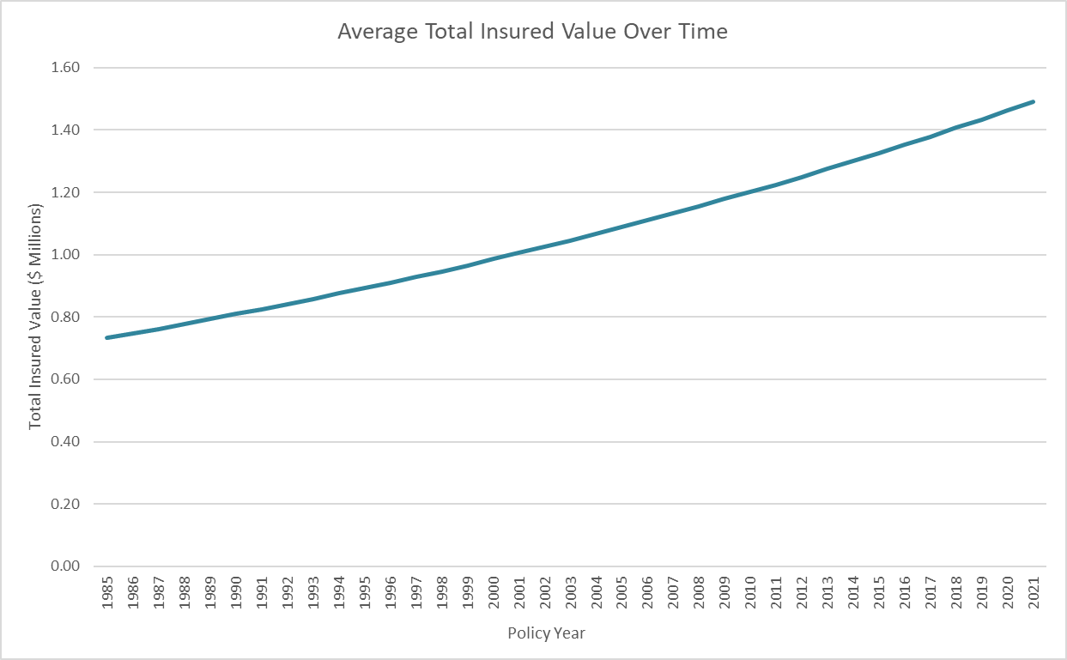
Average Total Insured Value (TIV) Over Time
Master Data → Exposures
Location Breakdown:
Master Data → TIV By Location

Slide 8
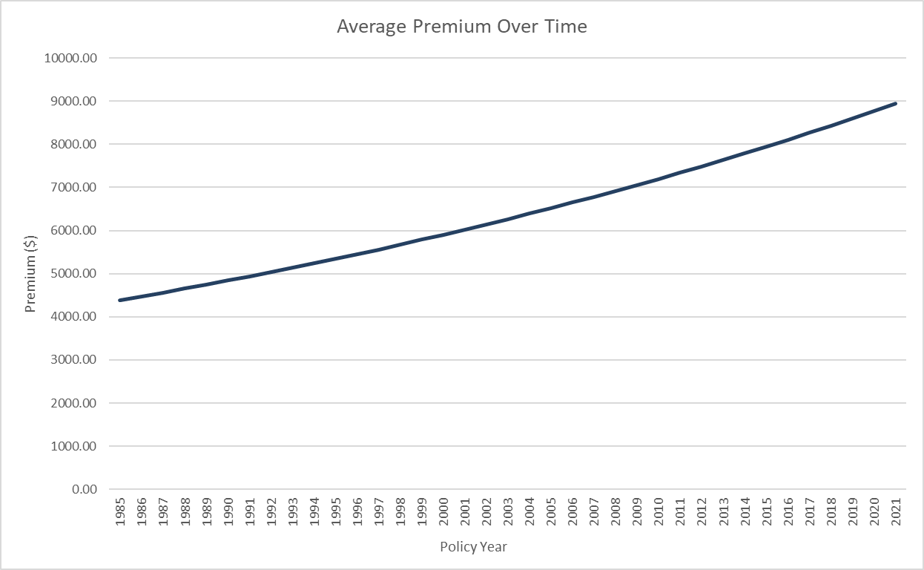
Average Premium Over Time
Master Data → Exposures
Location Breakdown:
Master Data → Prem By Location

Slide 9
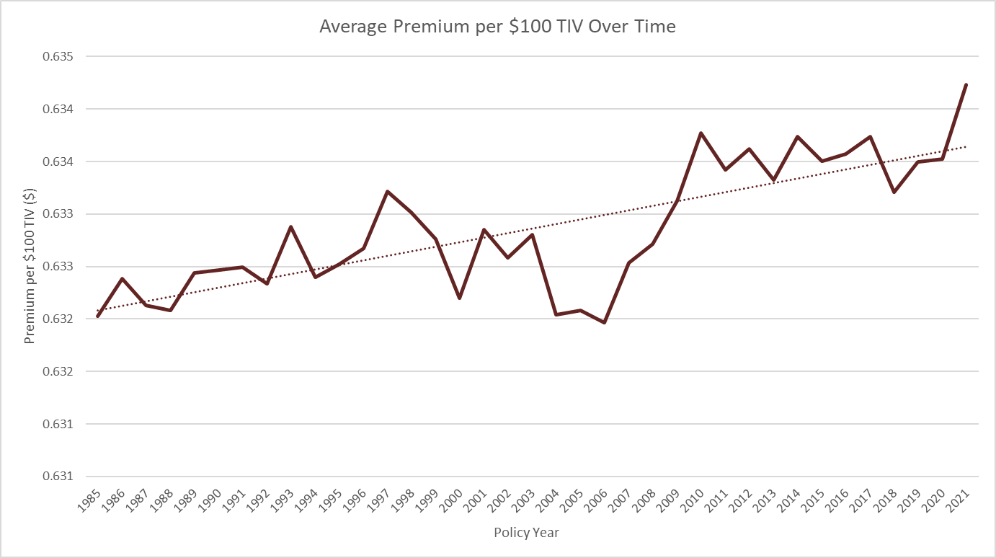
Average Premium/$100TIV Over Time
Location Breakdown:
Master Data → Prem per $100 TIV By Location
Master Data → Exposures

Slide 10
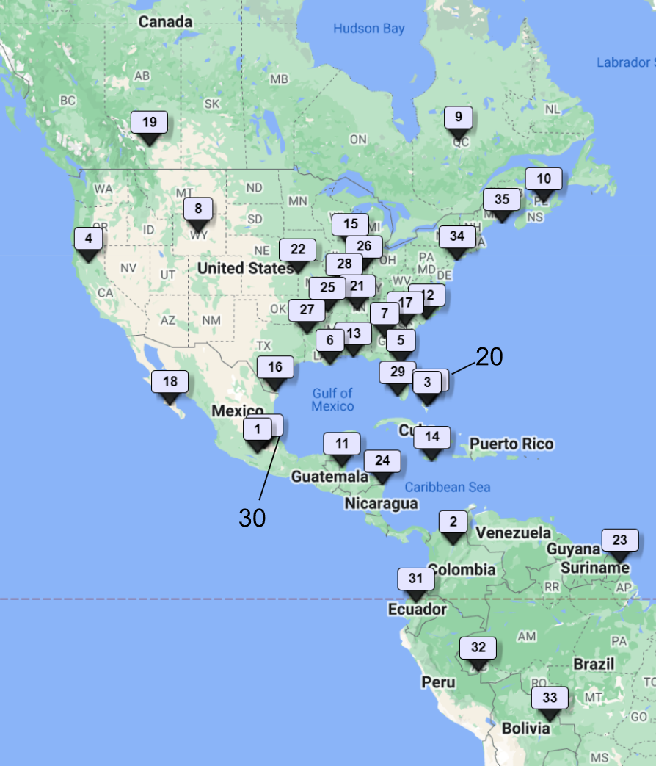
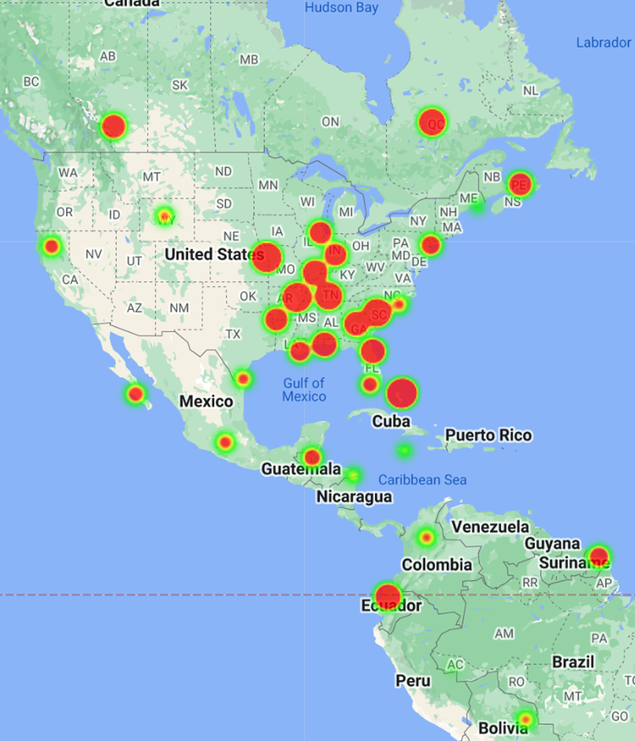
Portfolio by Geographic Location
Location #
TIV
Heat Maps → location numbers; TIV maps

Slide 11
02
Hurricane Data

Slide 12
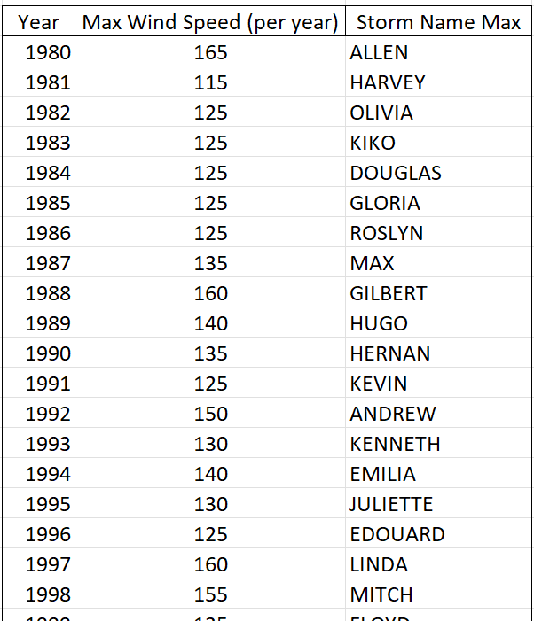
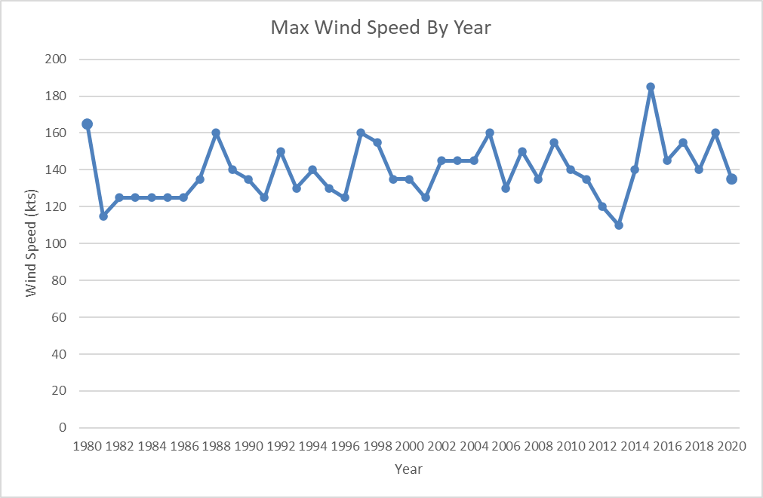
Max Wind Speed By Year
Master Data → Max Wind Speeds

Slide 13
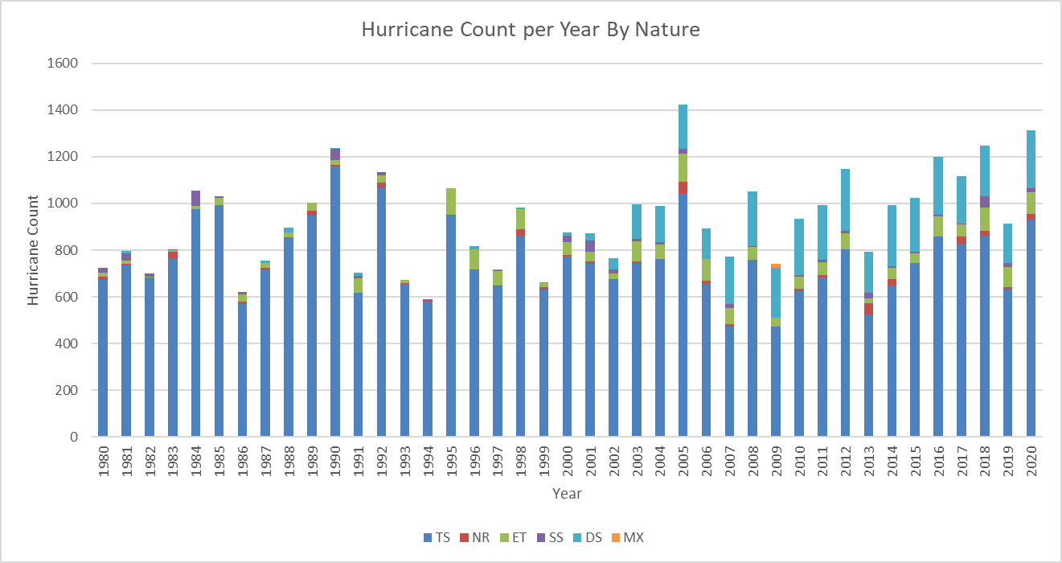
Hurricane Count per Year by Nature
Master Data → Max Wind Speeds

Slide 14
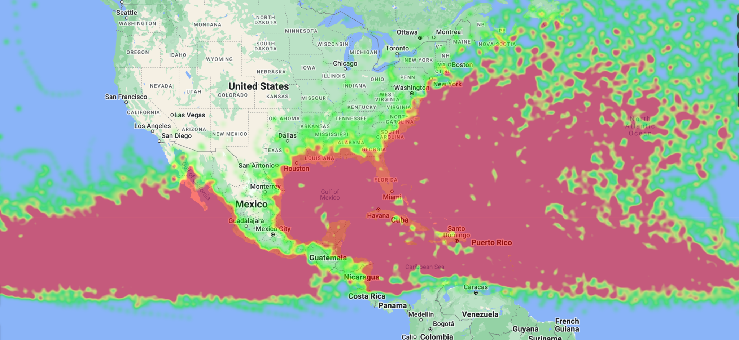
Hurricane Wind Speed Heat Map
Heat Maps → hurricane wind speed heat map

Slide 15
03
At-Risk Location Data

Slide 16
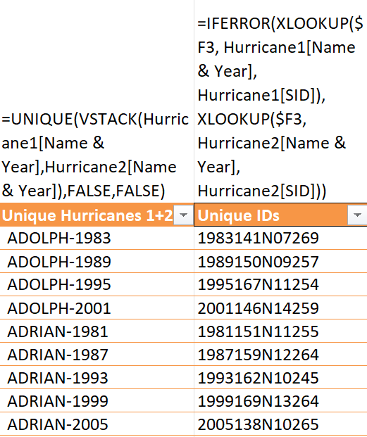
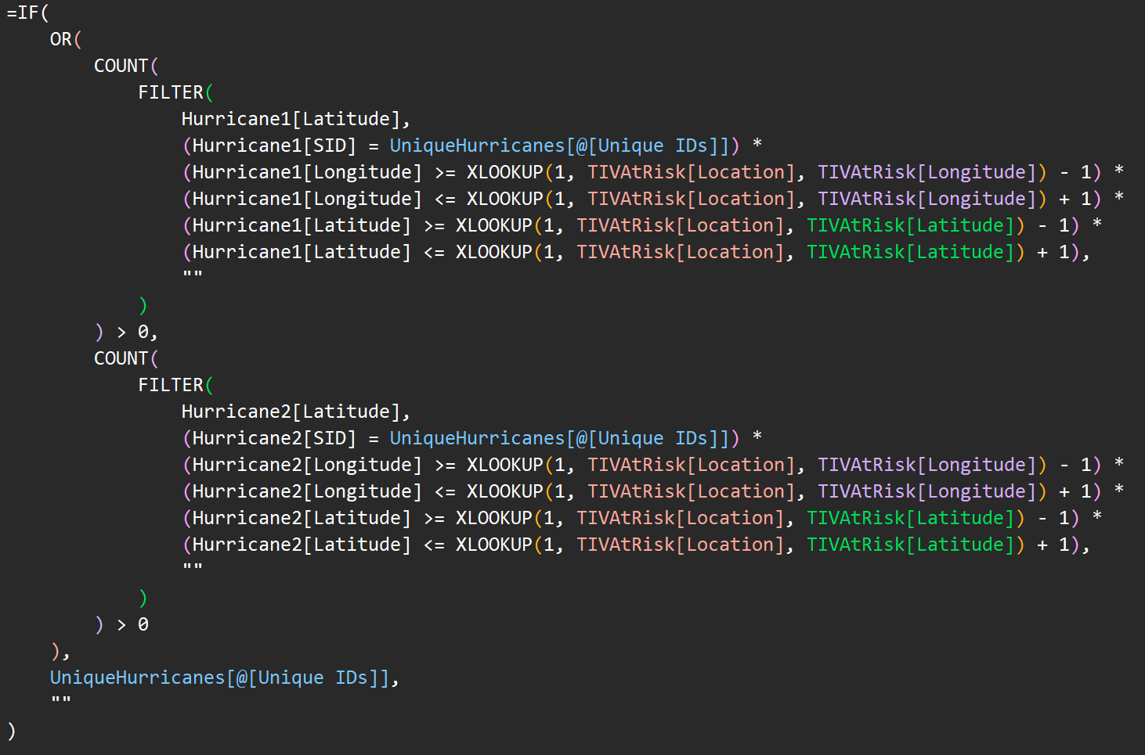
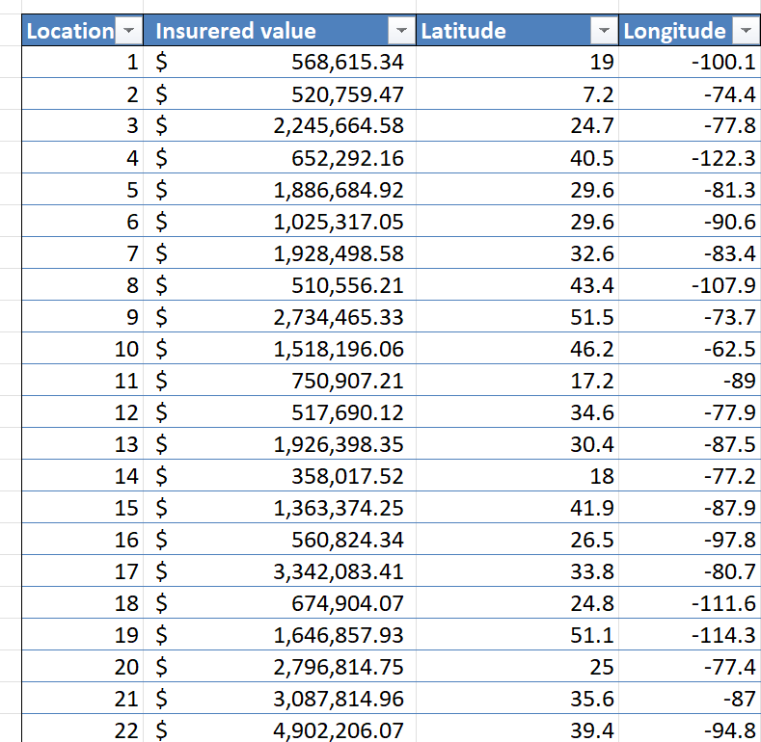
Collection Method
→
Master Data → Management Request 2

Slide 17
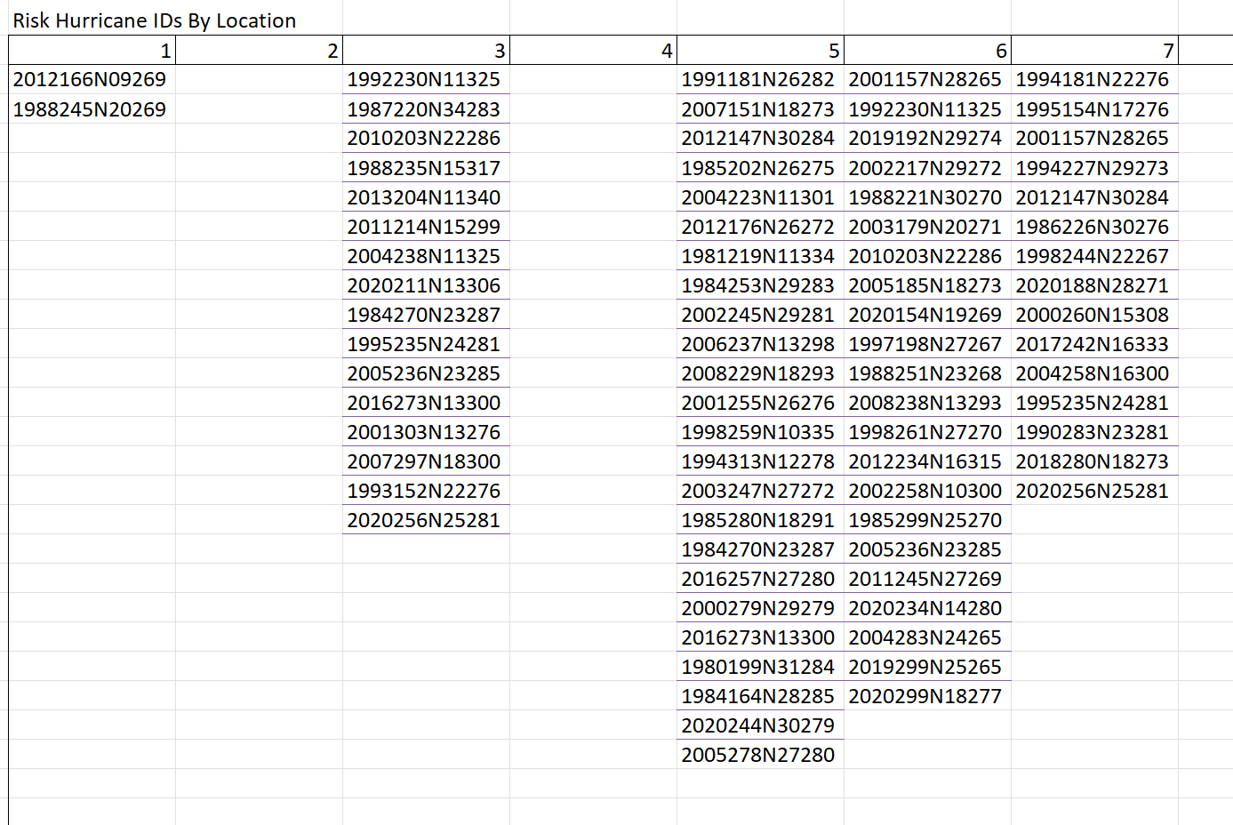
Collection Method
VSTACK(Columns)
V/X LOOKUP (Related Data)
Remove Blanks →
→
Master Data → Management Request 2

Slide 18
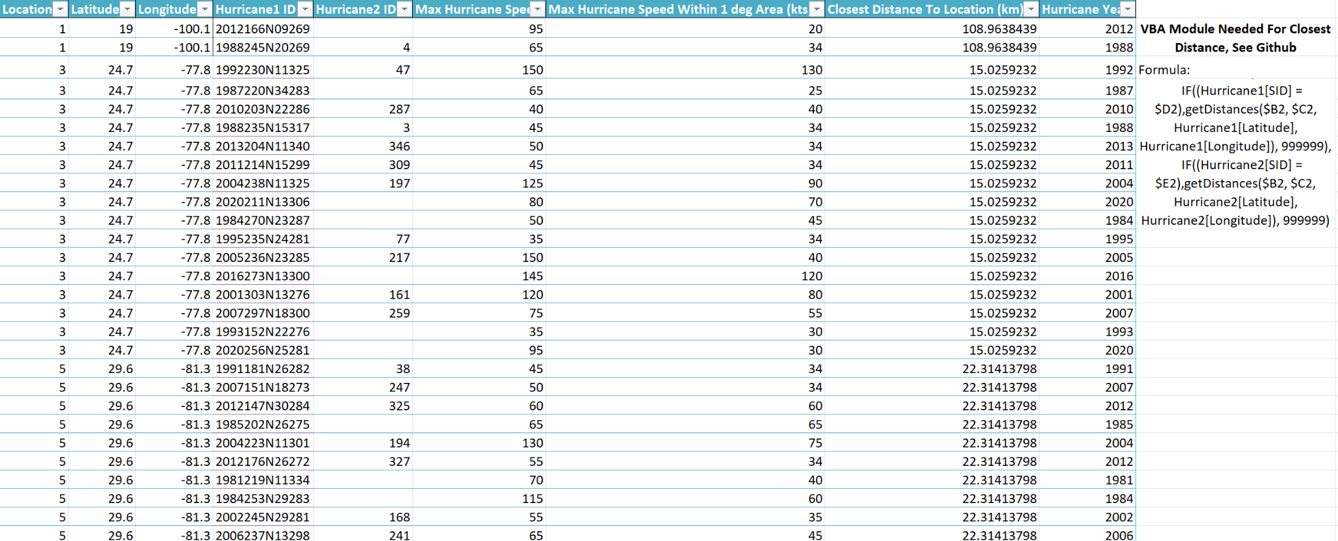
At-Risk Location Data
Master Data → Req 2 Dataset
HaversineDist.bas

Slide 19
04
Conclusions

Slide 20
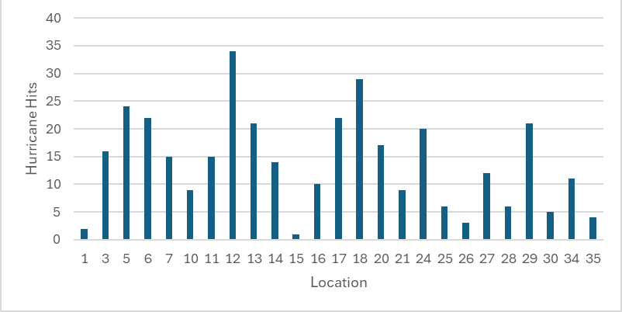
All-Time Hurricane Hits by Location
Mean = 13.94​
Considered High Risk if 13+​
Medium Risk 3-13​
Low Risk 0-2
Master Data → Management Request 2

Slide 21
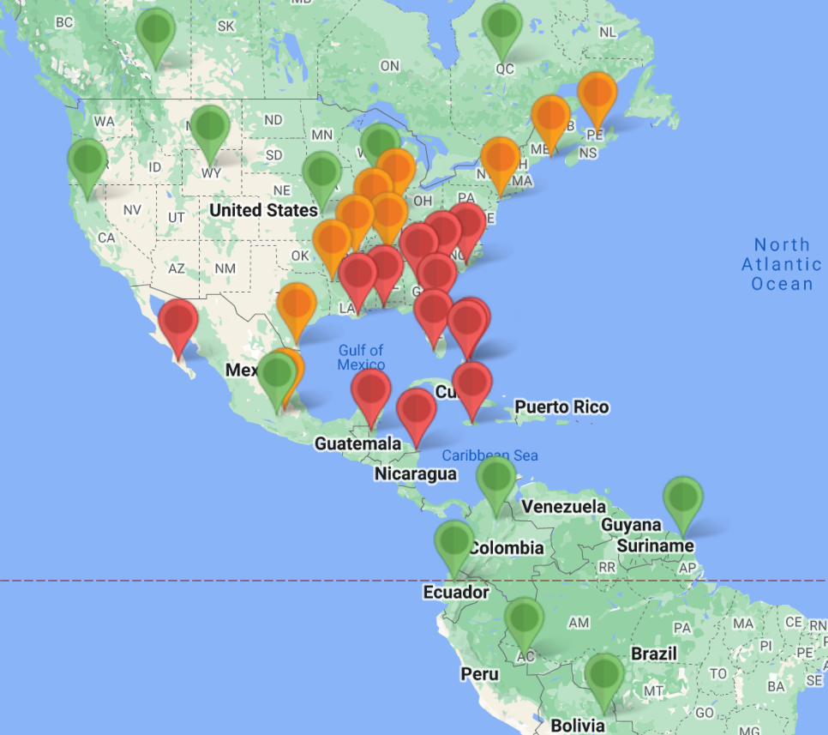
Frequency Risk Level By Location
High Risk | Medium Risk​ | Low Risk​
3, 5, 6, 7, 11, 12, 13, 14, 17, 18, 20, 24, 29 | 10, 16, 21, 25, 26, 27, 28, 30, 34, 35 | 1, 2, 4, 8, 9,15, 19, 22, 23, 31, 32, 33
Frequency Risk Index ~ Wind Speeds
This connection is intuitive, suggesting that this risk index is likely representative of expected catastrophic damages
Heat Maps → locations by frequency risk

Slide 22
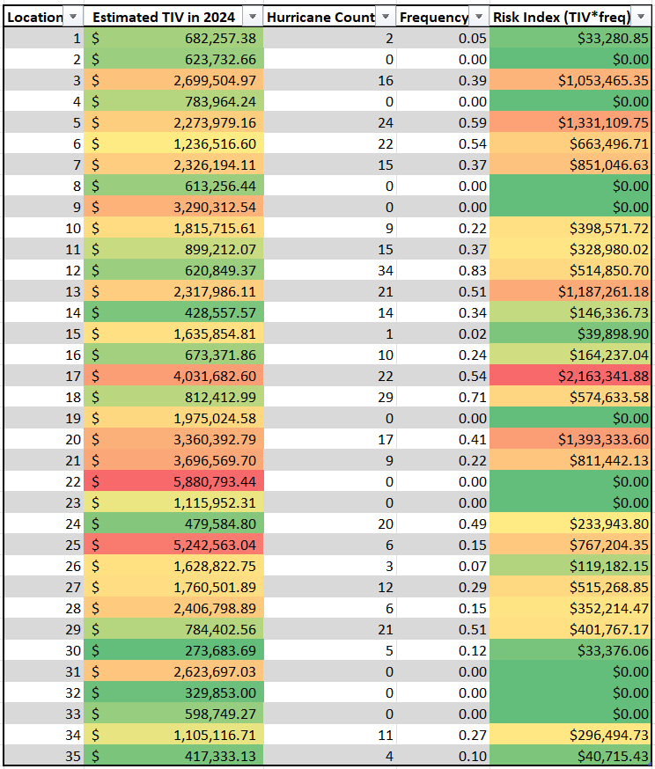
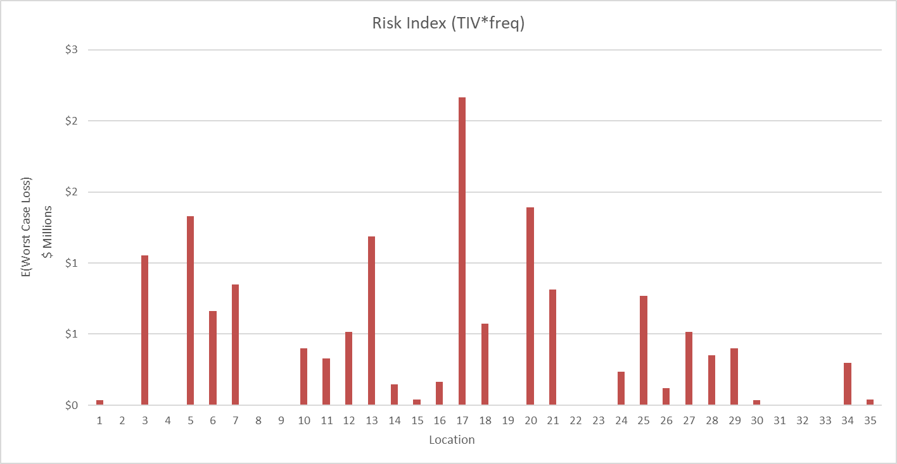
2024 Worst Case Expected Loss (Risk Index)
Assumptions:
Every loss = max loss = 2024 TIV
TIV inflation [2021, 2024] ~ US inflation [2021, 2024]
E(Worst Case Loss) = Hurricane Freq * 2024 TIV
Master Data → Management Request 2

Slide 23
05
Interface

Slide 24



Install
→
→
Setup Environment and Add:
pandas
openpyxl

Slide 25
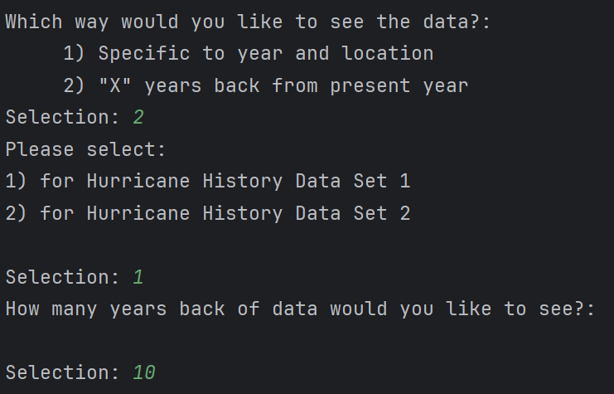
Sample Run Input

Slide 26
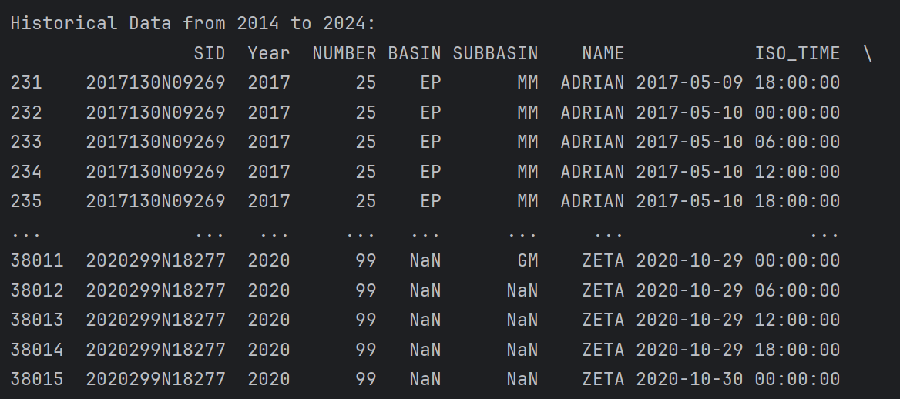
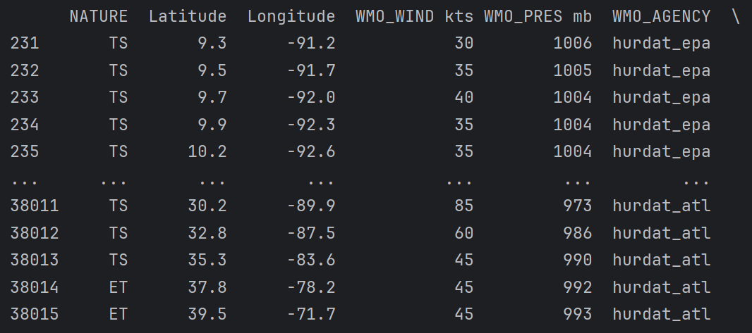
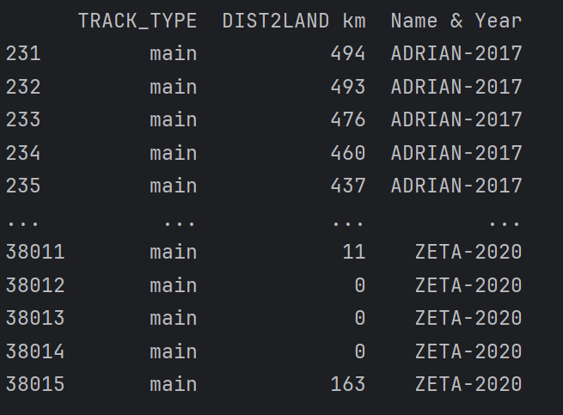
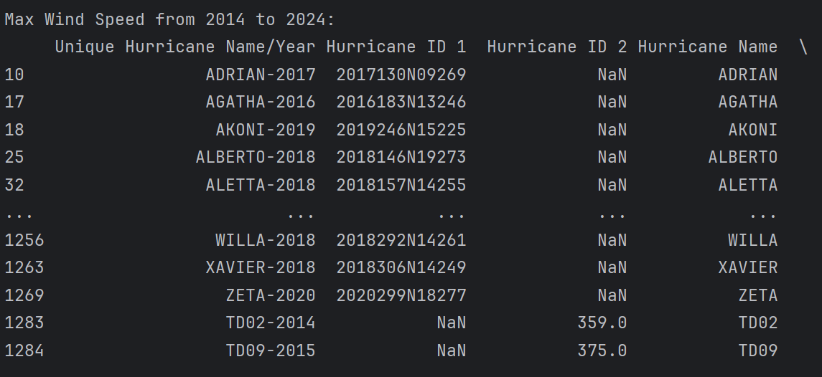
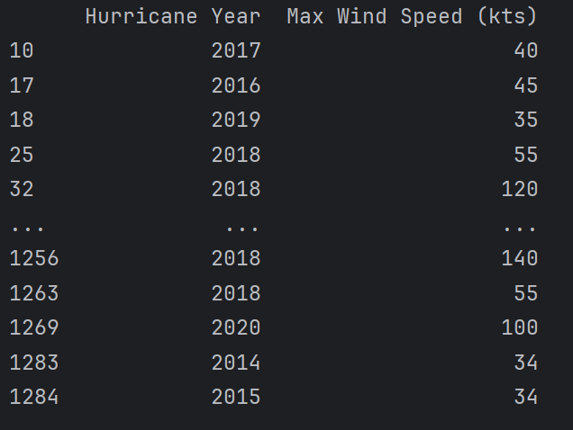
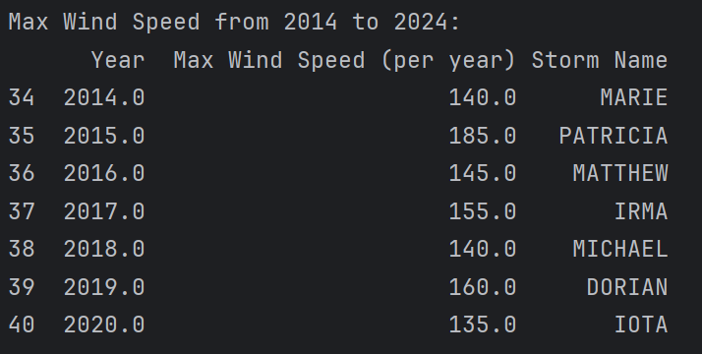
Sample Run Output

Slide 27
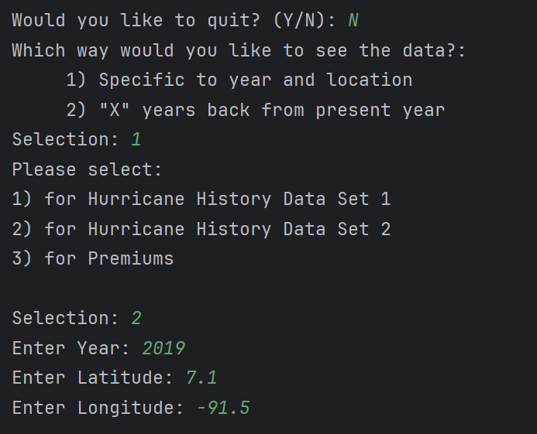
Sample Run Input 2

Slide 28
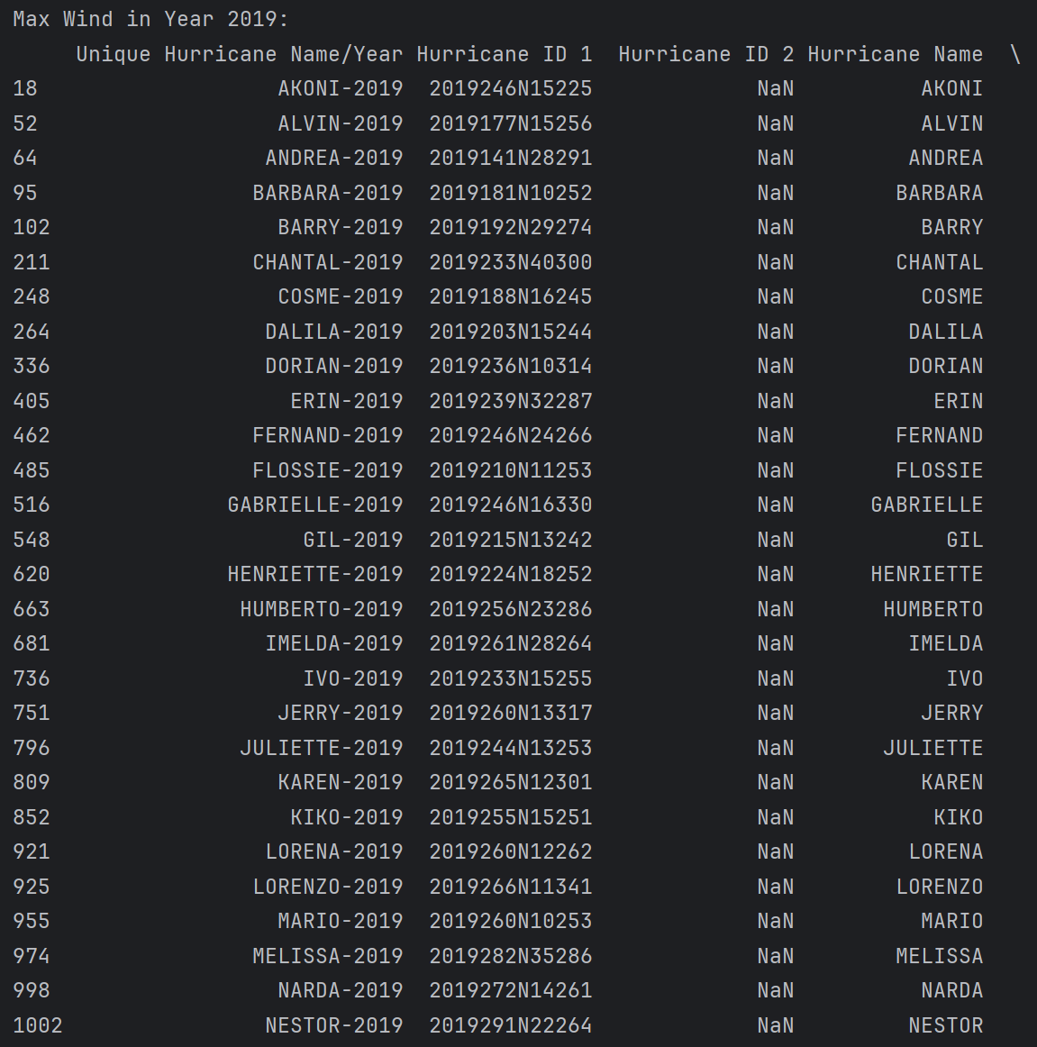
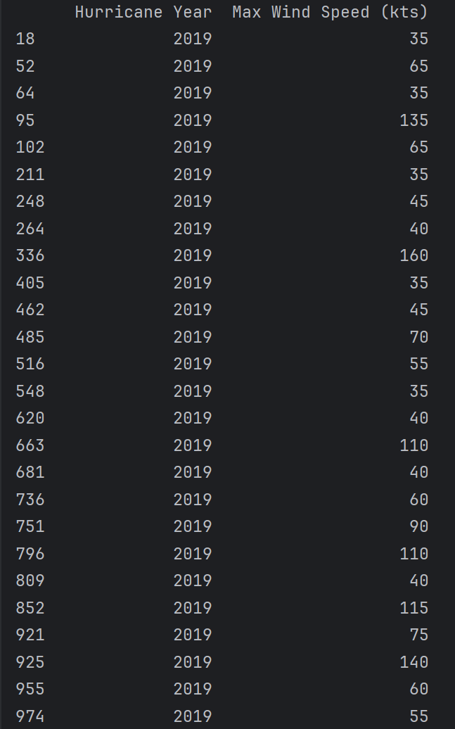
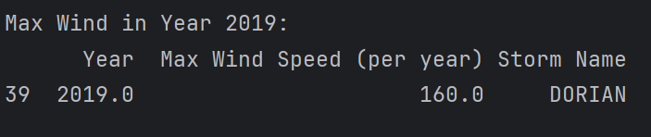
Sample Run Output 2

Slide 29
06
Areas of Uncertainty

Slide 30
Main Issue: Lack of Catastrophic Loss Data
Lacking Response Variable for At-Risk Data
The absence of historic catastrophe losses makes it impossible to use the at-risk location data to build a model for catastrophic loss based on the available predictors. No response variable = no model.
No Historical Catastrophic Risk Index
Without catastrophic loss data, it is not possible to confirm our location hurricane risk groupings with actual losses. We can only make general risk indices based on the frequency and/or intensity of past hurricanes proximal to the location.
No External Data
It is almost impossible to access localized catastrophic loss datasets, as this information is typically proprietary and only available to insurers.

Slide 31
Questions?
Please keep this slide for attribution

